Slide 1
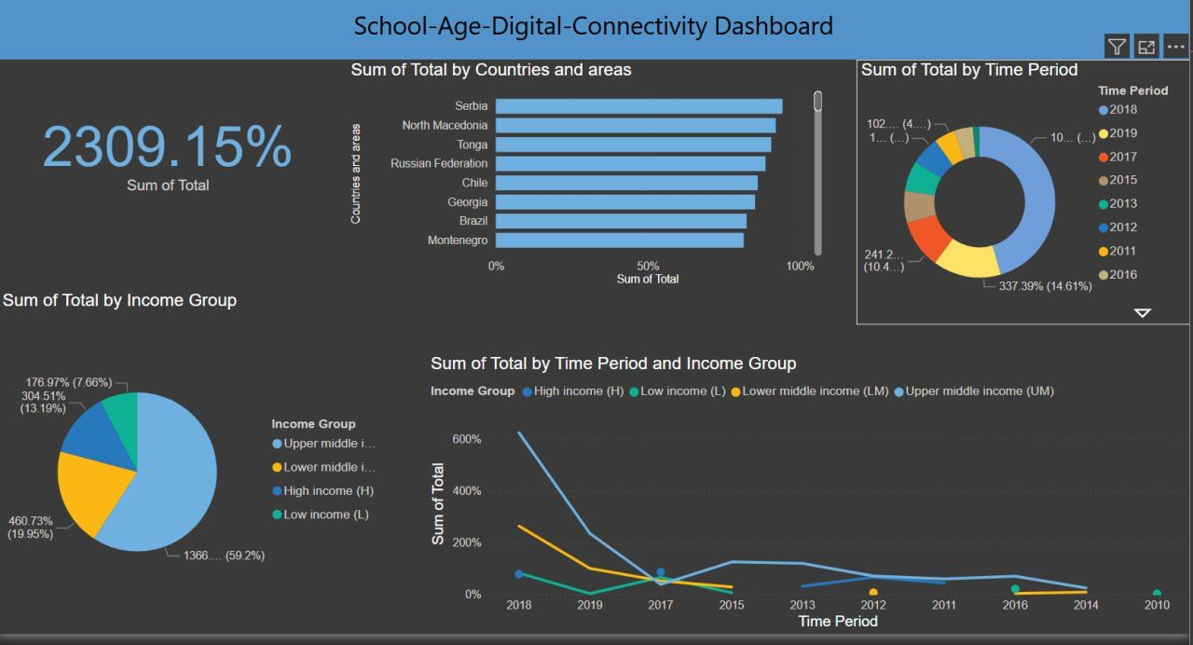
Created a dashboard to show the visual elements that we used.

Slide 2
These are the visual elements we decided to use in our Dashboard:
Obvious Trends
Digital Connectivity Peaked Around 2018 The line chart shows a sharp decline in connectivity after 2018, especially for high-income groups. The donut chart confirms that 2016, 2017, and 2018 had the highest connectivity contributions.
2. High-Income and Upper-Middle-Income Groups Dominate The pie chart shows that upper-middle-income (UM) and high-income (H) groups contribute the most to digital connectivity. Lower-income groups (LM and L) have much lower contributions.
3. Some Countries Contribute Significantly More The bar chart highlights that Serbia, North Macedonia, and Tonga are among the top contributors. Other countries contribute far less, indicating regional disparities in digital connectivity.
4. Steady Decline Across All Income Groups After 2018The line chart suggests that all income groups saw a decline in connectivity after 2018.However, the high-income group experienced the most drastic drop.
Key Insight: Connectivity efforts peaked around 2018 but have declined since.Income and regional disparities persist, with wealthier nations and income groups contributing more.
Reason: Helps viewers quickly identify sections, interpret data, and navigate the dashboard without confusion.

Slide 3
Clear Headings and Key
Title: School-Age Digital Connectivity Dashboard
This dashboard provides insights into digital connectivity trends among school-age children across different regions, time periods, and income groups.
Key Visual Elements e.g. Sum of Total (2309.15%)
A large numeric representation of the overall total percentage value.It indicates a cumulative measure, but the high percentage suggests that the metric may be a relative or indexed figure.
Reason: Helps viewers quickly identify sections, interpret data, and navigate the dashboard without confusion.
Relevant Comparison
Income Group Comparisons – The Wealth Gap in Digital Access
Evidence: The pie chart shows that upper-middle-income (UM) and high-income (H) groups dominate. Lower-income (L) and lower-middle-income (LM) groups contribute the least.
Comparison to Average: High and upper-middle-income groups combined account for nearly 70% of total connectivity, while low-income groups remain far below the average.
Reason: Helps viewers understand disparities, make informed decisions, and draw meaningful conclusions.

Slide 4
Art Design Elements
Color Coding for Categories : Different colors represent time periods, income groups, and regions across charts.
Color coding improves clarity and category differentiation.
Diverse chart types make data easy to analyze.
Key metrics in large fonts help emphasize crucial numbers.
Well-labeled graphs ensure better understanding.
Dark theme with bright colors improves contrast and readability.
Reason: Makes the dashboard visually appealing, improves engagement, and directs attention to important details.
Consolidated Insights
Connectivity peaked in 2018 but has dropped since.
Higher-income groups lead digital access, while lower-income groups lag.
A few countries drive most of the progress, leaving many behind.
All groups saw a decline after 2018, with high-income nations hit hardest.
Reason: It conveys several ideas at once in an easily understandable way.

